Slide 1

Organizational Behavior
(MGT-502)
Lecture-25

Slide 2
Summary of
Lecture-24

Slide 3
Concept of Power
Power - the ability to influence another person
Influence - the process of affecting the thoughts, behavior, & feelings of another person
Authority - the right to influence another person
Notes:
2

Slide 4
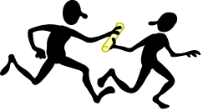
Sources of Organizational Power: Interpersonal
Reward Power - agent’s ability to control the rewards that the target wants
Coercive Power - agent’s ability to cause an unpleasant experience for a target
Legitimate Power - agent and target agree that agent has influential rights, based on position and mutual agreement
Referent Power-based on interpersonal attraction
Expert Power - agent has knowledge target needs
Notes:
4

Slide 5
Dependency: The Key To Power

Slide 6
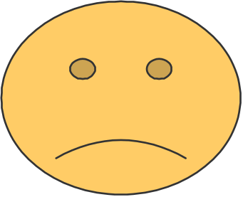

Two Faces of Power
Personal Power
  used for personal gain
Social Power
  used to create motivation
  used to accomplish group goals
Notes:
7

Slide 7
Today’s Topics

Slide 8
Contingency Variables that Influence Use of Power Tactics
Manager
  Personality
  Relative Power
  Objectives for wanting to influence
Employee
  Perception of employee’s willingness and ability to comply
Organization Culture

Slide 9
Examples: Power & its Use in Organizations
Different forms of harassment
Political behavior
Groups & coalitions
Impression management
Ethics and Power

Slide 10
The Power Corruption Cycle
Power and Resources
with no Accountability
Employee Reactions
Compliance
Submission
Dependence
Distance from
Employees
Consequences
Poor Decisions
Coercion
Lower Morale
Ethics Violations
Inflated View
Notes:
7

Slide 11
Political Behavior in Organizations
Organizational Politics - the use of power and influence in organizations
Political Behavior - actions not officially sanctioned by an organization that are taken to influence others in order to meet one’s personal goals
Notes:
14

Slide 12
“Playing Politics” in an Organization
Game Playing
  Political behavior in organizations has been described by many researchers in terms of game playing.
Political Influence Tactics
  Individuals and groups engage in political behavior in order to influence the perceptions or behavior of other individuals and groups.

Slide 13
“Playing Politics” in an Organization
Impression Management
  A political strategy which refers to actions individuals take to control the impressions that others form of them. It represents a deliberate attempt to leave a desirable impression on others. The desired impression may or may not be an accurate one.

Slide 14
Political Activity Levels
1.3
1.2
1.1
1.0
.9
.8
.7
.6
.5
.4
.3
.2
.1
Political activity
is perceived to
increase at higher
organizational levels
(1.22)
(1.07)
(.73)
Political Activity is Likely (range 0-3)
(.54)
(.50)
(.18)
Production
blue collar
Clerical
Technical and
professional
Lower
Mgmt.
Middle
Mgmt.
Upper
Mgmt.
Organizational Level

Slide 15
Political Maneuvering in Organizations
Political maneuvering
  Political strategy
    Plan to reach a goal using specific political tactics
    Goal: organizational or personal
  Political tactics
    Builds power base
    Uses power

Slide 16
Political Maneuvering in Organizations (Cont.)
Political strategy
  Specifies combinations and sequences of political tactics
  Includes plan for responding to changes in the political context
  People at all levels can develop and use a political strategy
  Not written; usually tacit

Slide 17
Political strategy (cont.)
  Used in
    Resource allocation
    Choice of senior managers
    Career decisions
    Performance appraisals
    Pay increase decisions

Slide 18
Political tactics
  Decision making processes
    Selectively emphasize decision alternatives
    Influence decision process in favor of self or work unit
  Control the decision making agenda: often done when person does not want change

Slide 19
Political tactics (cont.)
  Build coalitions
    Form around people inside and outside the organization
    Those believed important to person’s position
  Co-optation: get support by putting possible opponents on a task force or advisory board

Slide 20
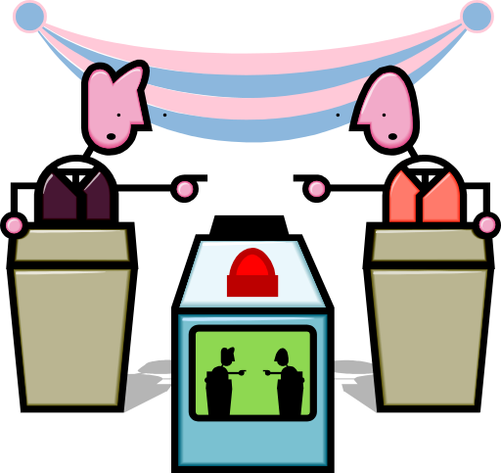
Political Tactics
Attacking or blaming others
Using information as a political tool
Creating a favorable image (impression management)
Developing a base of support
Praising others (ingratiation)
Forming political coalitions with strong allies
Associating with influential people
Creating obligations (reciprocity)

Slide 21
Influence Tactics
Consultation
Rational persuasion
Inspirational appeals
Ingratiation
Upward appeals
Coalition tactics
Exchange tactics
Pressure
Upward Influence the boss
Lateral Influence a coworker
Downward Influence
an employee
Notes:
16

Slide 22
Individual Factors Which Contribute to Political Behavior
Level of self monitoring
Need for power
Internal locus of control
Investment in the organization
Perceived alternatives
Expectations of success

Slide 23
Organizational Factors Which Contribute to Political Behavior
Low trust
Democratic decision making
High performance pressures
Scarcity of resources
Role ambiguity
Self-serving senior managers
Unclear evaluation systems
Zero-sum allocations

Slide 24
Types of Organizational Politics
Managing
impressions
Attacking and
blaming
Types of
Organizational
Politics
Creating
obligations
Controlling
information
Cultivating
networks
Forming
coalitions

Slide 25
Conditions for Organizational Politics
Personal
Characteristics
Scarce
Resources
Conditions
Supporting
Organizational
Politics
Tolerance of
Politics
Complex and
Ambiguous
Decisions

Slide 26
What Encourages
Organizational Politics?
Uncertain Resource Allocation
Coordination and Integration
Leadership Changes
Notes:
11

Slide 27
The Dark Side of
Organizational Politics
Deception
Lying
Organizational
politics
Intimidation

Slide 28
Managing Organizational Politics
Reduce System Uncertainty
Reduce Competition
Break Existing Political Fiefdoms

Slide 29
Managing Political Behavior
Maintain open communication
Clarify performance expectations
Use participative management
Encourage cooperation among work groups
Manage scarce resources well
Provide a supportive organizational climate
Notes:
17

Slide 30
Managing Political Behavior
Encourage
Discourage
Relationships
Negativity
Negotiation
Self-Interest
Compromise
Destructive
Behavior
Notes:
13

Slide 31
Controlling Political Behavior
Provide
Sufficient
Resources
Remove
Political Norms
Introduce
Clear Rules
Hire
Low-Politics
Employees
Free Flowing
Information
Increase
Opportunities
for Dialogue
Manage Change
Effectively
Peer Pressure
Against Politics

Slide 32
Ethical Guidelines for Political Behavior
Unethical
Ethical
Question 1
Is the action
motivated by
self-serving
interests which
exclude the
goals of the
organization?
Yes
Question 3
Is the political
activity fair
and equitable?
Yes
No
No
Unethical
Yes
Question 2
Does the political
action respect
individual rights?
No
Unethical

Slide 33
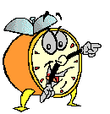
Let’s stop it here

Slide 34
Summary

Slide 35
Next….

Slide 36
Organizational Behavior
(MGT-502)
Lecture-25

